Slide 1
Model Evaluation (Consumer Valuation Models)
-Sounak Roy

Slide 2
1. Performance Metrics- Linear Regression Model
R-Squared
Adjusted R-Squared
Root Mean Squared Error (RMSE)
Mean Absolute Error (MAE)

Slide 3

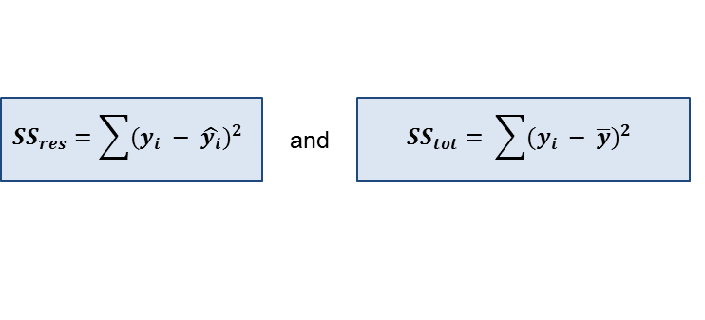
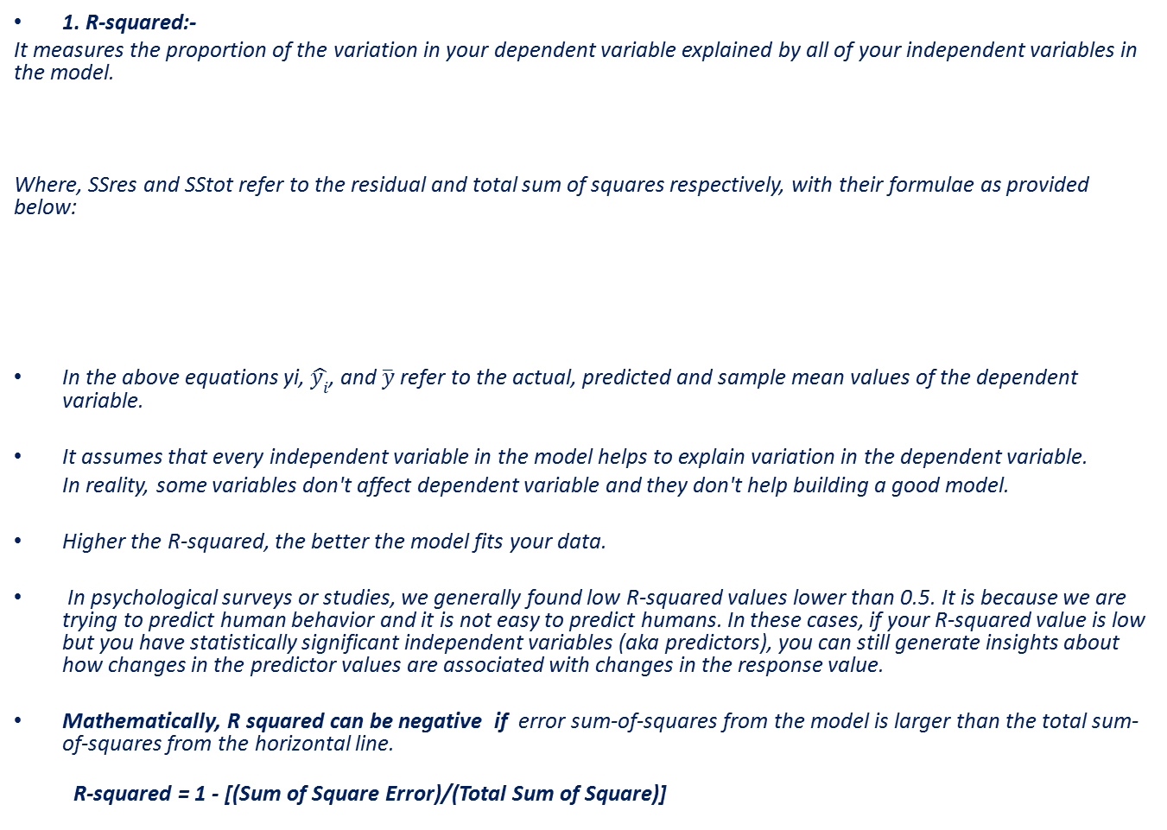
1. R-squared:-
It measures the proportion of the variation in your dependent variable explained by all of your independent variables in the model.
Where, SSres and SStot refer to the residual and total sum of squares respectively, with their formulae as provided below:
In the above equations yi, $\hat{y_{i}}$, and $\overline{y}$ refer to the actual, predicted and sample mean values of the dependent variable.
It assumes that every independent variable in the model helps to explain variation in the dependent variable.
In reality, some variables don't affect dependent variable and they don't help building a good model.
Higher the R-squared, the better the model fits your data.
In psychological surveys or studies, we generally found low R-squared values lower than 0.5. It is because we are trying to predict human behavior and it is not easy to predict humans. In these cases, if your R-squared value is low but you have statistically significant independent variables (aka predictors), you can still generate insights about how changes in the predictor values are associated with changes in the response value.
Mathematically, R squared can be negative if error sum-of-squares from the model is larger than the total sum-of-squares from the horizontal line.
R-squared = 1 - [(Sum of Square Error)/(Total Sum of Square)]

Slide 4
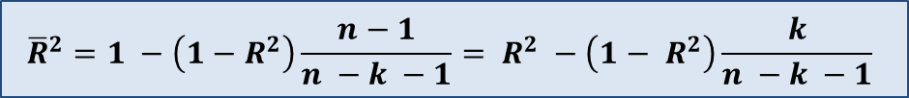
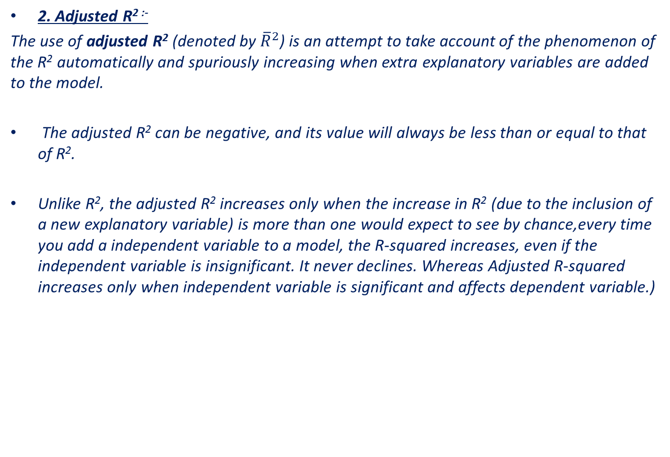
2. Adjusted R^{2 :-}
The use of adjusted R² (denoted by ${\overline{R}}^{2}$) is an attempt to take account of the phenomenon of the R² automatically and spuriously increasing when extra explanatory variables are added to the model.
The adjusted R² can be negative, and its value will always be less than or equal to that of R².
Unlike R², the adjusted R² increases only when the increase in R² (due to the inclusion of a new explanatory variable) is more than one would expect to see by chance,every time you add a independent variable to a model, the R-squared increases, even if the independent variable is insignificant. It never declines. Whereas Adjusted R-squared increases only when independent variable is significant and affects dependent variable.)
In the above formula, k denotes the total number of explanatory variables in the model, excluding the constant term, and n denotes the sample size.

Slide 5

3. RMSE ( Root Mean Square Error)
It explains how close the actual data points are to the model’s predicted values.
It measures standard deviation of the residuals.
In the formula above, yi is the actual values of dependent variable and
yi-hat is the predicted values, n - sample size. RMSE has the same unit as dependent variable.
R-squared is in proportion and has no units associated to target variable whereas RMSE has units associated to target variable. Hence, R-squared is a relative measure of fit, RMSE is an absolute measure of fit.
Lower values of RMSE indicate better fit. RMSE is a good measure of how accurately the model predicts the response, and is the most important criterion for fit if the main purpose of the model is prediction.
The RMSE for your training and your test sets should be very similar if you have built a good model.
If the RMSE for the test set is much higher than that of the training set, it is likely that you've badly over-fit the data, i.e. you've created a model that works well in sample, but has little predictive value when tested out of sample

Slide 6

Mean Absolute Error (MAE):
MAE measures the average magnitude of the errors in a set of predictions, without considering their direction.
It’s the average over the test sample of the absolute differences between prediction and actual observation where all individual differences have equal weight.
If the absolute value is not taken (the signs of the errors are not removed), the average error becomes the Mean Bias Error (MBE) and is usually intended to measure average model bias.
Similarities: Both MAE and RMSE express average model prediction error in units of the variable of interest. Both metrics can range from 0 to ∞ and are indifferent to the direction of errors. They are negatively-oriented scores, which means lower values are better.
Differences: Taking the square root of the average squared errors has some interesting implications for RMSE.
Since the errors are squared before they are averaged, the RMSE gives a relatively high weight to large errors. This means the RMSE should be more useful when large errors are particularly undesirable.

Slide 7
2. Performance Metrics- Logistic Model
Testing section | Conclusions
1. Model Performance Analysis/ Seperation Power of the Model | To show that the new model performance was better than existing model with respect to Kolmogorov-Smirnov (KS) statistics.
2. Model Alignment Charts | PDO calculated for new model was very close to the expected PDO.
3. Model Accuracy | Model accuracy was checked by using bad count error percentage(BCEP) and MAPE
4. Model Stability | With the help of population stability index(PSI), in order to show that population has not significantly shifted from development sample to OOT sample
5. Characteristics Analysis | Check whether all model variables were found to be stable in terms of bad rate and IV for development and OOT sample

Slide 8
1. Performance analysis
Performance Analysis (Development Vs OOT)
The Kolmogorov-Smirnov (KS) test is used to measure the difference between two probability distributions: in our case between the distribution of the good accounts and the distribution of the bad accounts with the score.

Slide 9
2. Model alignment
Model alignment was done by calculating the PDO (Point of Double Odds)
The objective of scaling is to convert the raw (model output) score into a scaled score (i.e. a standardized version) so that Business can assess and track changes in risk effectively (in measurement of odds).
The PDO is calculated only on the good and the bad observations. For a scale to be specified, the following three measurements need to be provided.
•Reference score: This can be any arbitrary score value, taken as a reference point.
•Odds at reference score: The odds of becoming a bad, at the reference score.
•PDO: Points to Double odds.
The scorecards were scaled such that 20 score points double the odds (PDO=20) and
A score of 600 corresponds to a good-bad odds of 60:1.
Raw score of each attribute was scaled to reflect the PDO and then rounded to the nearest integer.
The attribute scores were then added together to yield the final score.
PDO for Dev . & OOT should lie within 19-20 range (when PDO=20)

Slide 10
3. Model accuracy
Model accuracy was checked by calculating the Bad Count error percentage(BCEP) for Dev. &OOT sample .Check whether the BCEP for each model was within the permissible limit of +/- 25%
The BCEP values for all the models attached below. BCEP values for all the models were within the permissible limit.

Slide 11

4. Model Stability
To confirm whether the model is stable over time , we check the Population stability Index (PSI) in Dev. and OOT sample.
Check whether the PSI is within the range of +/- 25%
PSI for each of the models given below:-

Slide 12
5. Characteristic Analysis
The stability of each characteristic has been assessed by the characteristic stability analysis. The analysis proves that relationship pattern of the chosen scoring characteristic and risk confirms to business norm and intuition.
The chosen variables perform consistently across Dev & OOT samples.
CSI = (% of records based on scoring variable in Scoring Sample (A) - % of records based on scoring variable in Training Sample (B)) * In(A/ B)

Slide 13

3. Performance Metrics- Segmentation Model
Population stability: (Population Stability Index-PSI)
One key assumption of model development is that, the future population on which the strategies resultant from the segmentation will be applied should have similar properties with the past population on which segmentation was developed.
Measured by Population Stability Index (PSI), which measures the population distribution of the most recent available sample against the development or a reference sample.
Where P represents the most recent available sample and A represents the development
or a reference sample, with N terminal nodes.
Weight_P(i) and Weight_A(i) are the size weights of node(i), i = 1,2,…,N, for P and A respectively.
Therefore, Weight_P (1) + ……. + Weight_P (N) = 1, and Weight_A (1) + ……. + Weight_A (N) = 1.

Slide 14

Prediction Accuracy: (Average Absolute Deviation-AAD)
There should be minimal deviation of the segmentation from the design objective on each of the dimensions (business factors) targeted by the segmentation. Measured by Average Absolute Deviation (AAD), which compares the observed values of the relevant factor(s) against the benchmark/reference/expected values across the nodes of the segmentation.
Definition: Let i=1, 2… N index the terminal nodes of the segmentation. Calculate the Percent Average Absolute Difference (AAD) of the observed target variable (Target_P) with the benchmark (reference) target variable (Target_A) across the N nodes.
Where P represents validation sample and A reference sample, with N terminal nodes.
Target_P(i) and Target_A(i) are the target variable value of node(i), i = 1,2,…,N, for sample P and A respectively.
Weight_A(i) are the weight of node(i) of sample A, and Weight_A(1) + …….+ Weight_A(N) = 1.
For models with binary target variable, Weight_A(i) represents the percentage of accounts in node(i) to the total # of accounts.
For models with non-binary outcome, the weight should be calculated using the most relevant information to the target variable.
For example, if the target variable is $NCL rate, then the weight should be the percentage of $ENR of each node to the total $ENR.

Slide 15

Risk Ranking: (Rank Order Breaks-ROB)
Segmentation should have a clear risk ranking i.e. either a monotonic decreasing or increasing trend of risk should be present in all samples.
The consistency of rank ordering with respect to the targeted account credit performance metric (for example, good/bad rate, charge-off rate, NCL rate) must be assessed across the nodes for the segmentation unless account credit performance is not applicable to the segmentation.
Measured by Percentage of Rank Order Breaks (ROB):
Definition: Let Ri denote the rank of each node across the performance/target variable (e.g. loss rate) dimension in the reference/benchmark sample with R1 = 1, R2 = 2… RN = N representing the rank order by the performance/target variable values arranged from the highest to the lowest value. Let V1, V2… Vn denote the rank of each node across the same but in the validation sample.
Where N is the total number of terminal nodes in the model; Ri is the rank of the i th node in the reference sample. Vi is the rank of the same node on the validation sample;
Where Norm_factor = ROUNDUP (N/2, 0)*TRUNC (N/2, 0), represents the worst case scenario of ROB given N terminal nodes.

Slide 16

Discriminatory Power of the Model (Separation Power of Index):-
The separation power of the segmentation for all samples with respect to the targeted account/customer performance metric (for example, good/bad rate, charge-off rate, NCL rate) must be assessed.
Measured by Separation Power Index (SPI)
Definition: Let Ri denote the rank of each node across the dependent variable (e.g. loss rate) dimension in the reference/benchmark sample with R1 = 1, R2 = 2… RN = N representing the rank order by the target variable values arranged from the highest to the lowest. High_10% denotes the cumulative value of the target variable within the nodes representing 10% of accounts cumulated from the top, and Low_10% denotes the cumulative value of the target variable within the nodes representing 10% of accounts cumulated from the bottom, based on the reference model rank ordering grid.
Where Mean is a measure of the overall bad rate of the sample.
In cases where the highest /lowest node has more than 10% of the total population, take the value of the target variable of the highest/lowest node as High_10% / Low_10%.
In cases where the highest / lowest node has less than 10% of the total population, take the proportion of the next level node to attain 10% of the population

Slide 17
Threshold limits to decide the Model to be Robust & Stable:
Metrics should show similar
Performance in all samples (Development, OOT and recent validations)
SPI: > 1.2 (indicates Higher Discriminatory power)
PSI: >= 25% (indicates Population shift)
AAD <25% (lesser the value better is the accuracy)

Slide 18
Appendix
Performance Metrics
Additional

Slide 19
Thank You !!

